Slide 1

Language Learners' Interaction and the Production of Modified Output
Do Thi Quy Thu
Hue University, College of Foreign Languages
Vietnam

Slide 2
1. Introduction
Comprehensible Output Hypothesis:
necessity of opportunities for NNSs to produce comprehensible output in SLA
learners need to be “pushed” into making their output more precise, coherent, and appropriate
Swain (1985)

Slide 3
1. Introduction
Previous studies investigating Swain’s hypothesis:
collect data mostly from NS/NNS interactions (e.g., Pica, 1988; Linnell, 1996; Nobuyoshi & Ellis, 1993)
not consider the comparison between NNS/NNS and NS/NNS interactions (except for Varonis & Gass, 1985, 1994; Pica et al., 1996)

Slide 4
2. Research questions
Based on Pica et al.’s study (1996) and Iwashita’s study (2001),
the study investigated NNS/NNS vs. NS/NNS interactions and
1. Opportunities for modified output through interactional moves
  2. Types of interactional moves provided to other interlocutors
  3. Production of modified output in response to interactional moves.

Slide 5
Hypothesis
Hypothesis | Prediction
1.Opportunities for modified output | NNS/NNS dyads ≠ NS/NNS dyads
2.Proportions of interactional moves | NNS/NNS dyads ≠ NS/NNS dyads NNSs ≠ NSs
3.Production of modified output (MO) | NNS/NNS dyads < NS/NNS dyads

Slide 6

3. Methodology
3.1. Subjects
15 NNSs of English, 5 NSs of English:
5 NS/NNS dyads and 5 NNS/NNS dyads
3.2. Communicative tasks
One-way information gap tasks adapted from related studies (see, e.g., Pica et al., 1996; Iwashita, 2001)
3.3. Data collection procedures
20 audio-recordings:
10 dyads performing 2 communication tasks

Slide 7
3. Methodology
3.4. Data transcription and analysis
Data transcribed and coded for linguistic features:
  interaction moves : confirmation checks and clarification requests
  types of modified outputs: lexical modifications and syntactic modifications (see samples)
Data analysed using an analysis of variance (ANOVA) test

Slide 8
4. Results and Discussion
Table 1. Summary of results
Hypothesis | Prediction | Supported?
1.Opportunities for modified output | NNS/NNS dyads ≠ NS/NNS dyads | No
2.Proportions of interactional moves | NNS/NNS dyads ≠ NS/NNS dyads NNSs ≠ NSs | Yes Yes
3.Production of modified output (MO) | NNS/NNS dyads < NS/NNS dyads | Yes
(see ANOVA test_level of significance)

Slide 9
4.1. Hypothesis 1
Table 2
Interactional moves in c-units which provided opportunities to produce MO
 |  | Task 1 |  | Task 2 |  | Total
 |  | n | % | n | % | n | %
NNS/NNS dyads
Other c-units |  | 380 | 80 | 360 | 75 | 740 | 77.1
CC and CR* |  | 95 | 20 | 120 | 25 | 215 | 22.9
NS/NNS dyads
Other c-units |  | 405 | 80.2 | 415 | 72.2 | 820 | 75.9
CC and CR |  | 100 | 19.8 | 160 | 27.8 | 260 | 24.1
* CC, confirmation check; CR, clarification request

Slide 10
4.2. Hypothesis 2
Table 3
Proportion of CC and CR in NNS/NNS and NS/NNS dyads
 | Task 1 |  | Task 2 |  | Total
 | n | % | n | % | n | %
NNS/NNS dyads CC CR | 60 35 | 63.2 36.8 | 70 50 | 75 25 | 130 85 | 60.5 39.5
NS/NNS dyads CC CR | 70 30 | 80.2 19.8 | 9 160 | 5.3 94.7 | 79 190 | 29.4 70.6
(Additional notice from the 2 tasks in NS/NNS dyads: Task 1: NSs: information providers; NNSs: information receivers Task 2: NSs: information receivers, NNSs: information providers)

Slide 11
Hypothesis 2
1. NNS1: There is a teapot on the shelf.
NNS2: Teapot on the shelf? (CC)
NNS1: Aah, in the first layer.
NNS2: First layer? (CC)
NNS1: Yeah, the bottom one, the bottom layer.
There're three glasses on the shelf, the top layer.
NNS2: Ok, in the top layer. Three glasses? (CC)
NNS1: Yes.
And bottle, a bottle on the cupboard.
NNS2: Ok.
Excerpt 1. Example of frequent use of CC by NNSs.

Slide 12
Hypothesis 2
2. NNS: At the back. And next to the cat, on the carpet, we will see a magazine on the carpet.
NS: Is it on the left of the cat? (CR)
NNS: On the left, magazine, ok?
NS: Ok.
NNS: And on the right of the cat, you will see the...next to the sofa...you will see the...the lamp on the table, the round table.
NS: Where is the table? (CR)
NNS: It's behind.
NS: The lamp is on the table? (CR)
NNS: Yep. On the table, and a book is next to the lamp.
Excerpt 2. Examples of frequent use of CR by NSs.

Slide 13
4.3 Hypothesis 3
Table 4
Production of modified output in NNS/NNS and NS/NNS dyads
 | Task 1 |  | Task 2 |  | Total
 | n | % | n | % | n | %
NNS/NNS dyads Modified output Other responses | 20 80 | 20 80 | 25 95 | 20.8 79.2 | 45 175 | 20.5 79.5
NS/NNS dyads Modified output Other responses | 40 60 | 40 60 | 60 100 | 37.5 62.5 | 100 160 | 38.5 61.5

Slide 14
Hypothesis 3
Modified output: NS/NNS >NNS/NNS
NNSs’ modifications : syntactic type
NSs’: syntactic + lexical
NNSs’ syntactic modifications:
simple, short, mostly repeated from other interlocutors' prior utterances.

Slide 15

Hypothesis 3
3. NNS1: There's a saucepan in the cooker.
NNS2: On the cooker?
NNS1: Aah, on the cooker (syntactic modification)
NNS2: Which side, left or right?
NNS1: Uhm...on the cooker.
NNS2: Just on the cooker?
NNS1: Yeah, just put it on the cooker. (syntactic modification)
NNS2: Ok.
Excerpt 3. Examples of modifications used by NNSs.

Slide 16
Hypothesis 3
4. NS: the next shelf, on the left, teapot
NNS: teapot?
NS: Teapot, teapot has a handle on the side, that's on the left (lexical modification)
NNS: ok, I got it.
Excerpt 4. Examples of modifications used by NSs.

Slide 17
5. Conclusions and Implications
Opportunities for modifications: NNS/NNS ~ NNS/NS.
CR >CC in NS/NNS interactions:
  NSs: CR >CC in interactional moves.
  NNSs: mainly CC
Production of modified output: NS/NNS >NNS/NNS interactions.
NS’s responses:
  rich in lexical and structural modifications
  not a particularly rich context to aid learners in L2 learning, i.e. to produce modified output

Slide 18
Implications
Provide models of L2 morphosyntax in building L2 grammar  assist L2 acquisition
Identify, adapt or create suitable communicative tasks for classroom interactions
Provide opportunities for learners to modify interactions through negotiation.

Slide 19
References
Duff, P.A. (1986). Another look at interlanguage talk: talking task to task. In R. Day (Ed.), Talking to Learn: Conversation in Second Language Acquisition (pp. 147-181). Rowley, MA: Newbury House.
Gass, S. (2003). Input and interaction. In C. Doughty & M. H. Long (Eds.), The handbook of second language acquisition (pp. 224-255). London: Blackwell.
Gass, S., Varonis, E. (1985). Task variation and non-native/non-native negotiation of meaning. In S. Gass & C. Madden (Eds.), Input in Second Language Acquisition (pp. 149-161). Rowley, MA: Newbury House.
Gass, S., Varonis, E. (1986). Sex differences in NNS/NNS interactions. In R. Day (Ed.), Talking to Learn: Conversation in Second Language Acquisition (pp. 327-351). Rowley, MA: Newbury House.
Gass, S., Varonis, E. (1994). Input, interaction and second language production. Studies in Second Language Acquisition, 16, 283-302.
Iwashita, N. (2001). The effect of learner proficiency on interactional moves and modified output in nonnative-nonnative interaction in Japanese as a foreign language. System, 29, 267-287.
Iwashita, N. (1999). Tasks and learners’ output in nonnative-nonnative interaction. In K. Kanno (Ed.), Studies on the Acquisition of Japanese as a Second Language (pp. 31-52). Amsterdam: John Benjamin.
Linnell, J. (1996). Can negotiation provide a context for learning syntax in a second language? Working Paper in Educational Linguistics, 12, 83-102.
Nobuyoshi, J., Ellis, R. (1993). Focused communication tasks and second language acquisition. English Language Teaching Journal, 47, 203-210.
Pica, T. (1988). Interlanguage adjustments as an outcome of NS-NNS negotiated interaction. Language Learning, 28, 45-73.
Pica, T., Holliday, L., Lewis , N., Morgenthaler, L. (1989).Comprehensible output as an outcome of linguistic demands on the learner. Studies in Second language Acquisition, 11(1), 63-90.
Pica, T., Lincoln-Porter, F., Paninos, D., Linnel, J. (1996). Language learners' interaction: How does it address the input, output and feedback needs of L2 learners?. TESOL Quarterly 30(1), 59-84.
Shehadeh, A. (1999). Non-native speakers' production of modified comprehensible output and second language learning. Language Learning 49(4), 627-675.
Swain, M., 1985. Communicative competence: some roles of comprehensible input and comprehensible output in its development. In S. Gass & C. Madden (Eds), Input in Second Language Acquisition (pp. 235-253), Rowley, MA: Newbury House.
Watcyn-Jones, P. (1984). Penguin functional English. Great Britain: Penguin Books.
Yamaguchi, Y., (1994). Negative Evidence and Japanese as a Foreign Language Acquisition. Ms, University of Western Australia, Perth.

Slide 20
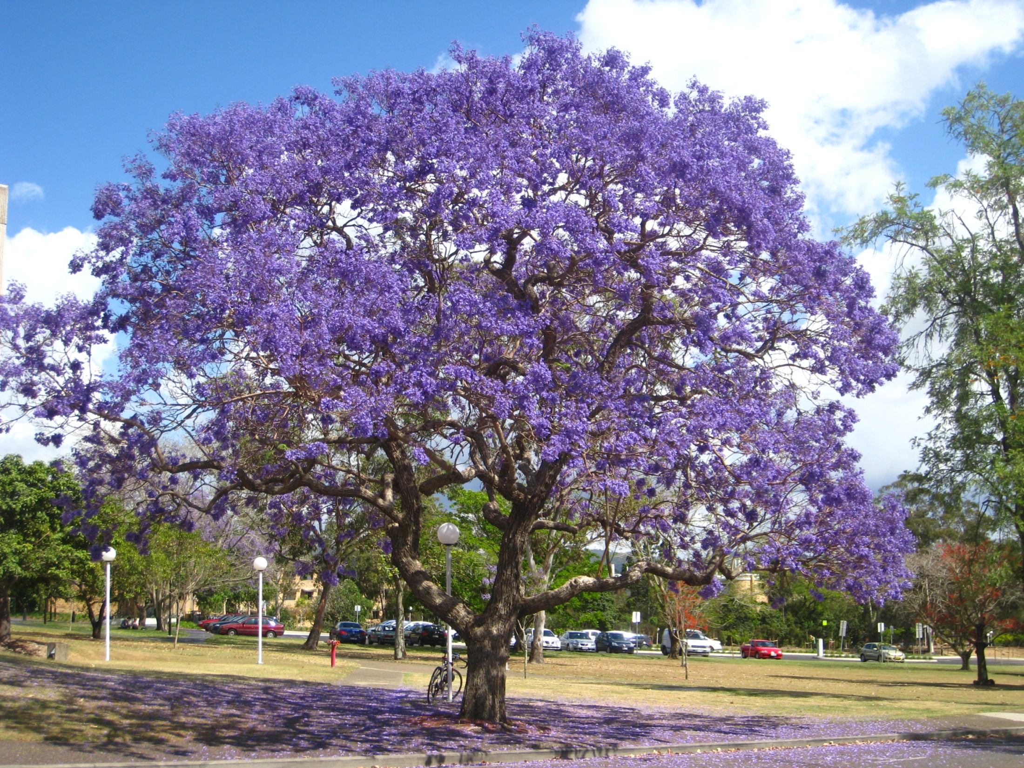
Thank you

